Slide 1
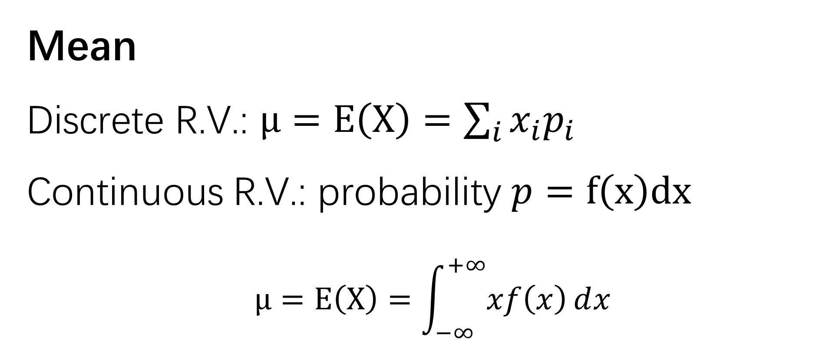
Mean
Discrete R.V.: $μ=E\left(X\right)=\sum_{i}{x_{i}p_{i}}$
Continuous R.V.: probability $p=f\left(x\right)dx$
$$μ=E\left(X\right)=\int_{−∞}^{+∞}{xf\left(x\right)ⅆx}$$

Slide 2
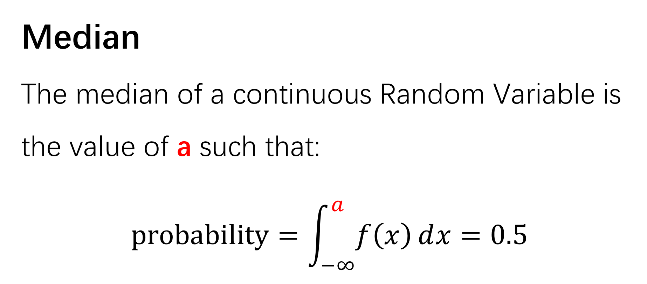
Median
The median of a continuous Random Variable is the value of a such that:
$$probability=\int_{−∞}^{a}{f\left(x\right)ⅆx}=0.5$$

Slide 3
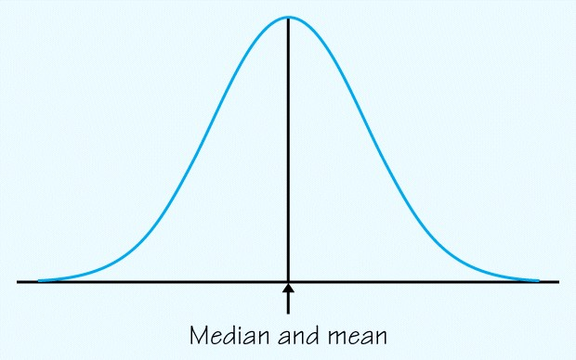
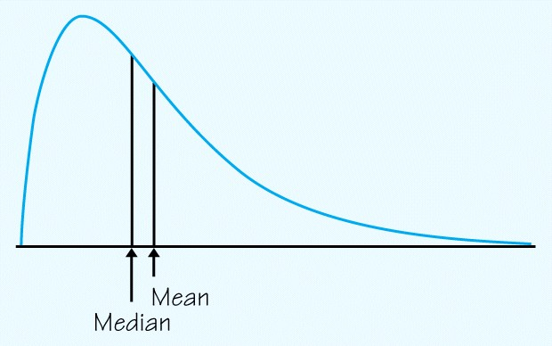
For a symmetric Density curve…
For a skewed density curve…

Slide 4
Normal Distribution
Notes:
那我们来看一下density curve里面最典型的一个分布：正态分布，normal Distribution

Slide 5
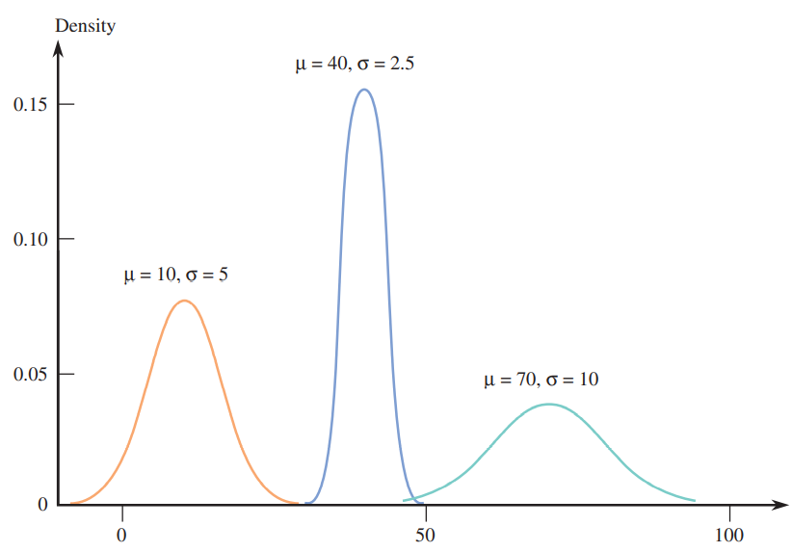

Normal Curves
Describe the density curve:
Shape: symmetric, single peak
Outlier: no obvious outliers
Center: Median = Mean
Spread: Standard deviation, Variance…
10
Notes:
这三个都是normal Distribution，大家来想一下我们怎么去描述他们的分布
Hint: 想一下我们用于描述Distribution的四点：SOCS
Shape: symmetric, single peak
Outlier: no obvious outliers
Center: Median = Mean
Spread: Standard deviation, Variance…
这四点里有哪些是这三个density curve的共同特点？
Shape 和 Outlier
那这两个合起来就是 normal curve的定义。

Slide 6
Normal Curves
Describe the density curve:
Shape: symmetric, single peak
Outlier: no obvious outliers
Center: Median = Mean
Spread: Standard deviation, Variance…
10

Slide 7
Normal Curves
A Normal distribution is described by a symmetric, single-peaked, bell-shaped density curve called a Normal curve.
All Normal distributions have the same overall shape.

Slide 8
Normal Curves
Describe the density curve:
Shape: symmetric, single peak
Outlier: no obvious outliers
Center: Median = Mean
Spread: Standard deviation, Variance…
10
Notes:
那这里面剩下的两点也就决定了 normal curve的具体形状，也就是说，如果我已知 center 和 spread的值，知道 mu 和 sigma，我就知道这个normal curve的方程式了

Slide 9
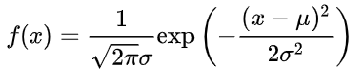
【Not required】
Notes:
它的density function是这样的，我们可以看一下，这个不会考，我们就看一下，这里面只有两个系数mu和sigma，所以知道这俩，我们的function就定了

Slide 10
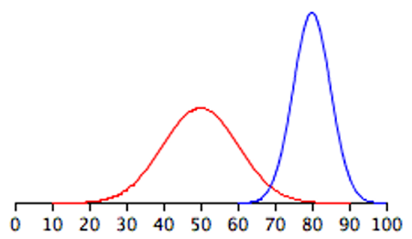

Normal Curves
Normal Curves
A Normal distribution is described by a symmetric, single-peaked, bell-shaped density curve called a Normal curve.
All Normal distributions have the same overall shape.
Any Normal distribution is completely specified by two numbers:
its mean μ and standard deviation σ.
Notes:
Any Normal distribution is completely specified by two numbers: its mean μ and standard deviation σ.
所以我们也可以把随机变量X写成 X ~ N(mu, sigma ^2)
这里需要注意一下，如果大家在写这个normal Distribution的时候，在N（ ，）第二个空这里写了一个数，那就默认为sigma ^2
这个是有标准的，也是很容易在考试中丢一些比较冤的分
如果你非得写标准差，那你就明确的写出来 sigma=…
那对于这两个系数，
均值 决定了这个density curve的中心在x轴上的位置
Sigma决定了这个curve是高高瘦瘦还是矮矮胖胖的
这两个curve，哪个的sigma要大一些？
左边的！因为数据分布的比较分散
右边的，数据更集中在中心

Slide 11


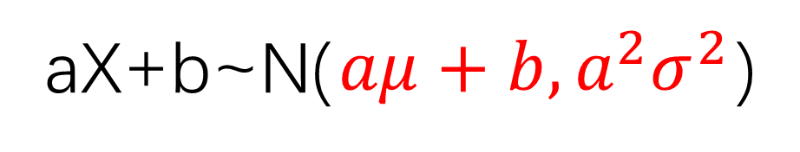

Properties
All Normal Distributions have the same overall shape.
If X follows the normal distribution,
aX+b still follows the normal distribution.
aX+b~N( ? , ? )
E(aX+b) = ?
$$aμ+b$$
aX+b~N($aμ+b,a^{2}σ^{2}$)
$$a^{2}σ^{2}$$
Var(aX+b) = ?
Notes:
因为我们刚刚提到的，All Normal Distributions have the same overall shape.
看一下它的性质：
所以我们对这个normal curve进行平移和拉伸或压缩并不会改变它的分布类别，它还是normal
也就是说，If X follows the normal distribution, aX+b still follows the normal distribution.
这个证明我们不要求掌握，感兴趣的同学自行知乎，有多种证明方式，最基础的是用cdf的导数来证
所以我们根据这个性质，能得到结论：
如果X~N(,),那 aX+b一定也是~N（，）
那具体的分布我们就要计算一下aX+b的期望和方差了
大家试一下计算一下

Slide 12
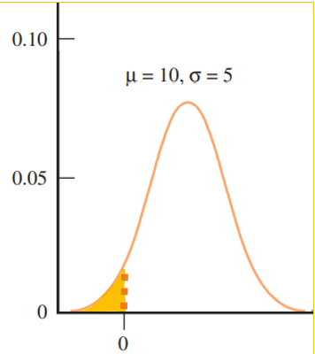
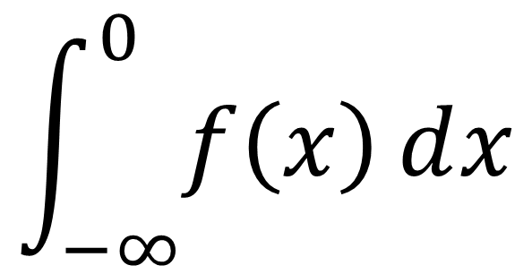
What is the value of P(X<0)?
$$\int_{−∞}^{0}{f\left(x\right)ⅆx}$$

Slide 13
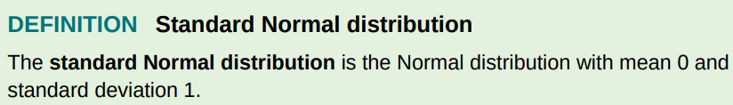
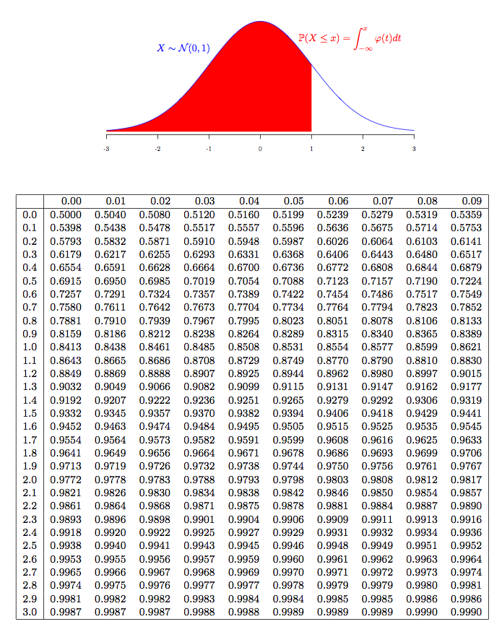

Z~N(0,1)
Notes:
再来看一个定义：
这是一个特殊的normal Distribution，算是normal curve里面的一个基准
当均值为0，方差为1的时候，就叫做standard normal Distribution，标准正态分布
我们一般来说会把服从标准正态分布的随机变量定义为Z，这个和我们之前接触的Z-score也是有一定联系的
它的图像是这样的，红色这部分的面积就是X<=x的概率，这个应该是个特别复杂的积分，我们不用自己算，可以查表
我们考试的时候会有一个正态分布的表，我们来看一下咋看

Slide 14
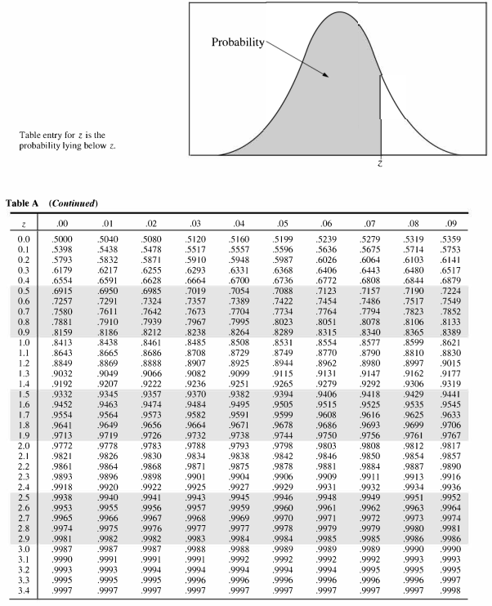
Notes:
这个就是这个表，大家在我们之前发的公示表里也能看到
上面是一个图，示意的是我们这个表里的概率指的都是≤某个值的概率

Slide 15
Notes:
下面的这部分
首先我们先看一下最左边的一列和最上面的一行，这个是Z的取值
中间则是对应的概率
比如蓝色框框里的，0.6179 就是 Z=0.30的概率，
它右边的0.6217对应的就是 Z=0.31的概率

Slide 16
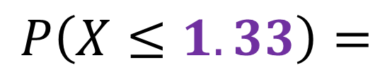

$$P\left(X≤1.33\right)=$$
$$0.9082$$
Notes:
举个例子
如果想求X<=1.33的概率，我们怎么找
首先我们要找到1.33，我们就需要找到1.3 和 0.03
那对应的0.9082就是它的概率了

Slide 17
Use the table of Standard Normal Curve Areas to find P(-1.76<Z<0.58)
P(-1.76<Z<0.58)
= P(Z<0.58) – P(Z<-1.76)
= P(Z<0.58) – [1-P(Z<1.76)]
= 0.7190 – 0.0392
= 0.6798
Notes:
练习一下

Slide 18
We only have the distribution table of the
STANDARD NORMAL DISTRIBUTION!!!
Notes:
但是我们不可能有一个分布，我就去算一个分布的表格，所以我们只有标准正态分布的表格
那如果我们遇到了均值不是0的随机变量了，想求概率的话咋办？

Slide 19

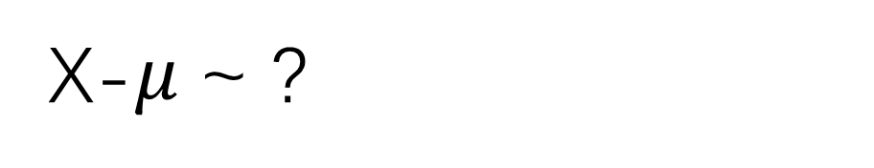

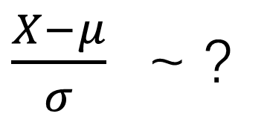

?
X ⬄
standard normal random variable
$$N(0,σ^{2})$$
Z-value (Z-score)
X-$μ$~ ?
$$Z=\frac{X−μ}{σ}$$
$\frac{X−μ}{σ}$~ ?
$$N(0,1)$$
P(X<x) = P($\frac{X−μ}{σ}$<$\frac{x−μ}{σ}$) =P(Z<$\frac{x−μ}{σ}$) Then use the table!
Notes:
怎么能把X和标准正态分布联系到一起呢？
Hint： x-mu的分布是什么样的？
我们也把这个叫做Z-score或者Z-value
如果我想求 X<x的概率我可以两边同时 –mu /sigma，那我就会得到一个N(0,1)的变量< x-mu/sigma 的概率
然后就可以查表了

Slide 20
Studies on automobile safety suggest that stopping distances follow an approximately Normal distribution. For one model of car traveling at 62 mph, the mean stopping distance is μ=155 ft with a standard deviation of σ=3 ft . Danielle is driving one of these cars at 62 mph when she spots a wreck 160 feet in front of her and needs to make an emergency stop. About what percent of cars of this model when going 62 mph would be able to make an emergency stop in less than 160 feet? Is Danielle likely to stop safely?

Slide 21
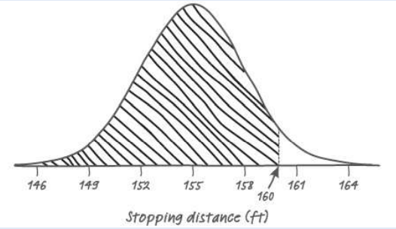
Studies on automobile safety suggest that stopping distances follow an approximately Normal distribution. For one model of car traveling at 62 mph, the mean stopping distance is μ=155 ft with a standard deviation of σ=3 ft . Danielle is driving one of these cars at 62 mph when she spots a wreck 160 feet in front of her and needs to make an emergency stop. About what percent of cars of this model when going 62 mph would be able to make an emergency stop in less than 160 feet? Is Danielle likely to stop safely?
X = stopping distance when a car traveling at 62 mph
X~N(155, 9)
P(X<160)=P(Z < (160 − 155)/3) = P(Z<1.67) = 0.9525.
About 95% of cars of this model would be able to make an emergency stop within 160 feet. So Danielle is likely to be able to stop safely.

Slide 22
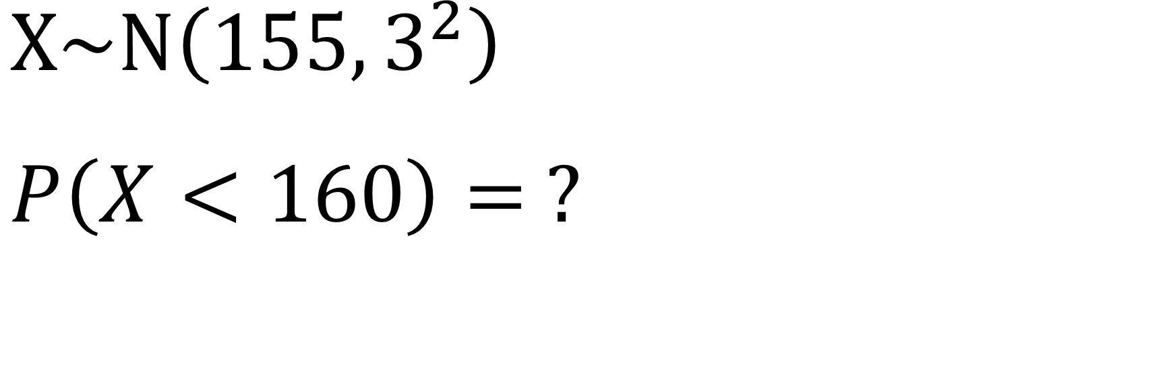
Calculator
$$X\sim N\left(155,3^{2}\right)$$
$$P\left(X<160\right)= ?$$
Notes:
注意 lower bound 千万不要设置成0！！ Normal有可能取到负无穷

Slide 23
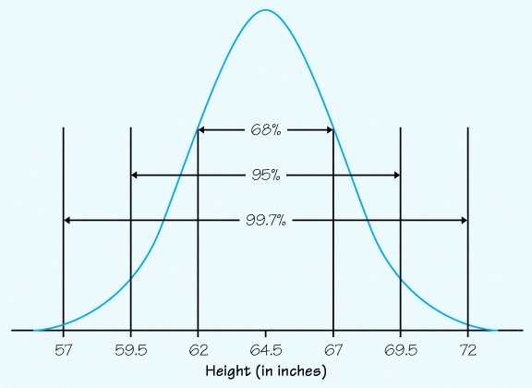
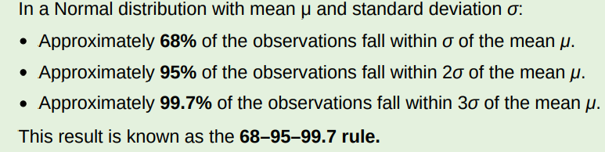
The
68–95–99.7
RULE
Notes:
大家对68 95 99.7还有没有印象，我们上周也提到过
这个其实是源于normal Distribution
对于正态分布来说，
均值+-一倍的标准差，会包含68%的数据
均值+-2倍的标准差，会包含95%的数据
均值+-3倍的标准差，会包含99.7%的数据

Slide 24
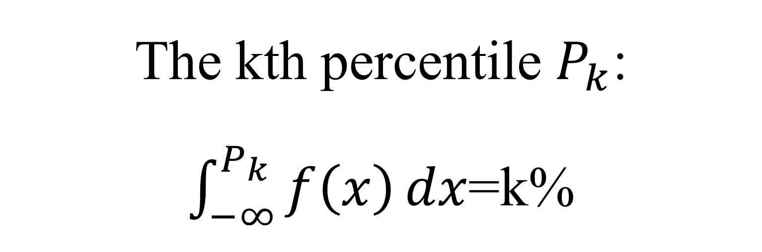
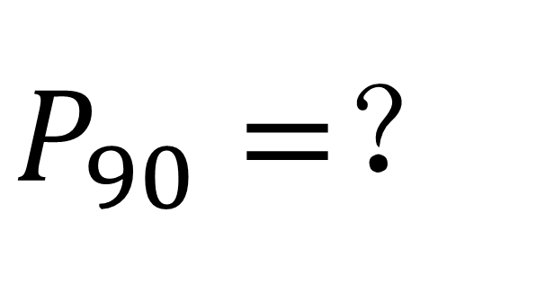
Percentiles
The percentile of a score, x, is the percentage of scores which fall at or below the score.
The kth percentile $P_{k}$:
$\int_{−∞}^{P_{k}}{f\left(x\right)}dx$=k%
$P_{90}=$？
Notes:
Percentile 百分位数，Pk对应的应该就是排在k%这个位置的值，所以：
如果我们现在想求 90th percentile,怎么求？
先看查表的方法怎么求：

Slide 25
Notes:
大概是1.285
看一下用计算器怎么找？
InvN，也就是反函数，已知概率，想去求对应的随机变量的区间取值

Slide 26
Determine the value of each of the following percentiles for the standard normal distribution (Hint: If the cumulative area that you must look for does not appear in the z table, use the closest entry):
The 91st percentile
The 77th percentile
c. The 50th percentile
d. The 9th percentile
e. What is the relationship between the 70th z percentile and the 30th z percentile?
Notes:
练习一下：
注意：如果用查表的方法的话，如果没有对应的概率，就找最近的进行估算

Slide 27
Determine the value of each of the following percentiles for the standard normal distribution (Hint: If the cumulative area that you must look for does not appear in the Z table, use the closest entry):
The 91st percentile 1.341
The 77th percentile 0.737
c. The 50th percentile 0
d. The 9th percentile -1.34
e. What is the relationship between the 70th z percentile and the 30th Z percentile?
70th z percentile = - 30th z percentile

Slide 28
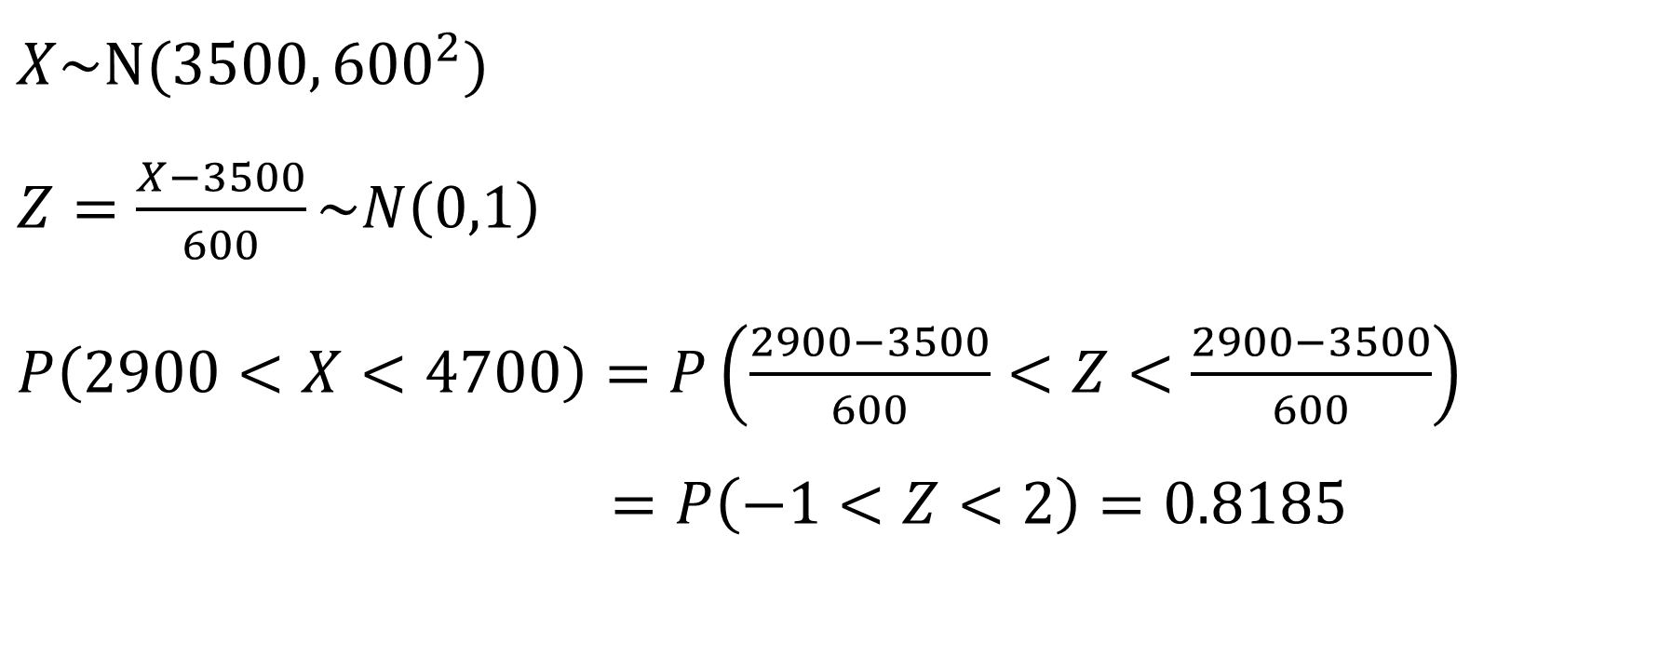
Data from the paper “Fetal … Composition” suggest that a normal distribution with mean 3500 grams and standard deviation 600 grams is a reasonable model for the probability distribution of the continuous numerical variable X = birth weight of a randomly selected full-term baby. What proportion of birth weights are between 2900 and 4700 grams?
$X\sim N(3500,{600}^{2})$
$Z=\frac{X−3500}{600}\sim N\left(0,1\right)$
$P\left(2900<X<4700\right)=P\left(\frac{2900−3500}{600}<Z<\frac{2900−3500}{600}\right)$
$=P\left(−1<Z<2\right)=0.8185$
Notes:
不用自己去算2900-3500/600的值，计算器会自己帮我们算出来

Slide 29
Garbage trucks entering a particular waste management facility are weighed and then they offload garbage into a landfill. Data from the paper “Estimating … GPS” suggest that a normal distribution with mean 13 minutes and standard deviation 3.9 minutes is a reasonable model for the probability distribution of the random variable X = total processing time for a garbage truck at this waste management facility (total processing time includes waiting time as well as the time required to weigh the truck and offload the garbage). Suppose that we want to describe the total processing times of the trucks making up the 10% with the longest processing times.

Slide 30
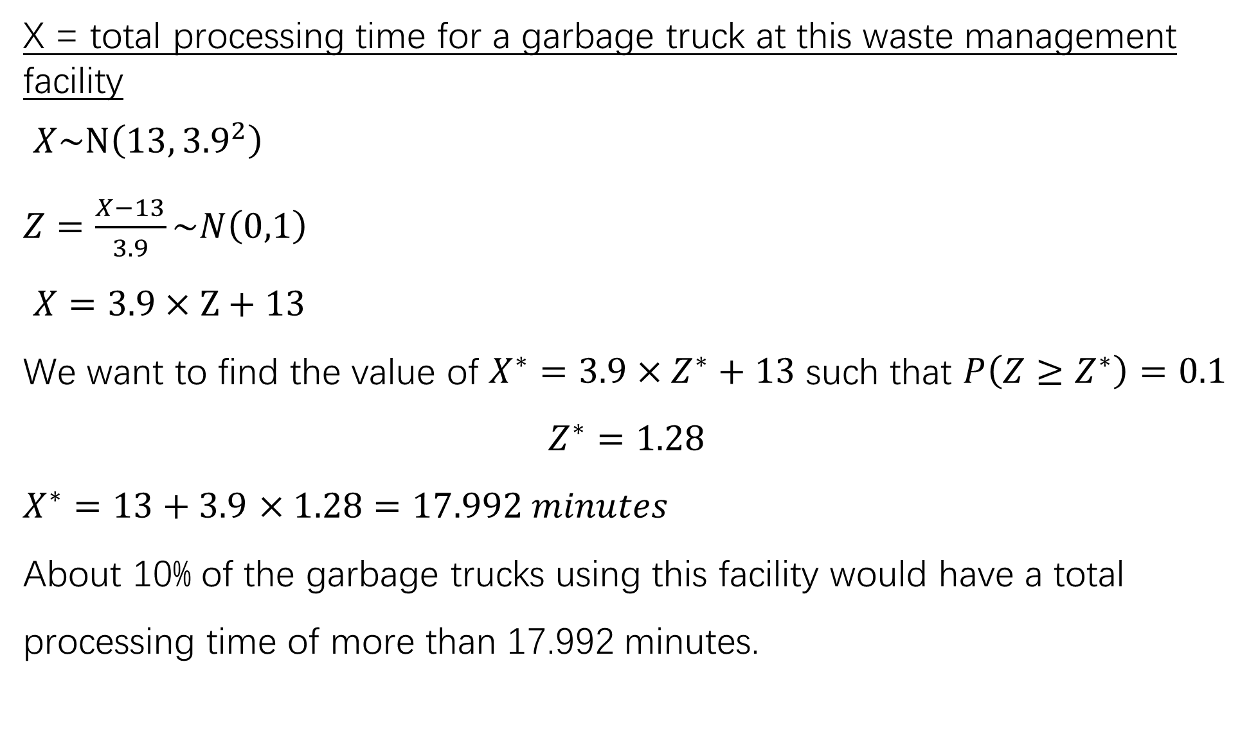
X = total processing time for a garbage truck at this waste management facility
$X\sim N\left(13,{3.9}^{2}\right)$
$Z=\frac{X−13}{3.9}\sim N\left(0,1\right)$
$X=3.9×Z+13$
We want to find the value of $X^{∗}=3.9×Z^{∗}+13$ such that $P\left(Z≥Z^{∗}\right)=0.1$
$$Z^{∗}=1.28$$
$X^{∗}=13+3.9$ $×1.28=17.992 minutes$
About 10% of the garbage trucks using this facility would have a total processing time of more than 17.992 minutes.

Slide 31
Determine the value of z* such that
-z* and z* separate the middle 95% of all z values from the most extreme 5%
-z* and z* separate the middle 90% of all z values from the most extreme 10%
-z* and z* separate the middle 98% of all z values from the most extreme 2%
-z* and z* separate the middle 92% of all z values from the most extreme 8%
Notes:
0.975 0.025
0.95 0.05
0.99 0.01
0.96 0.04

Slide 32
Determine the value of z* such that
-z* and z* separate the middle 95% of all z values from the most extreme 5% z*=1.96
-z* and z* separate the middle 90% of all z values from the most extreme 10% z*=1.645
-z* and z* separate the middle 98% of all z values from the most extreme 2% z*=2.33
-z* and z* separate the middle 92% of all z values from the most extreme 8% z*=1.75

